Slide 1

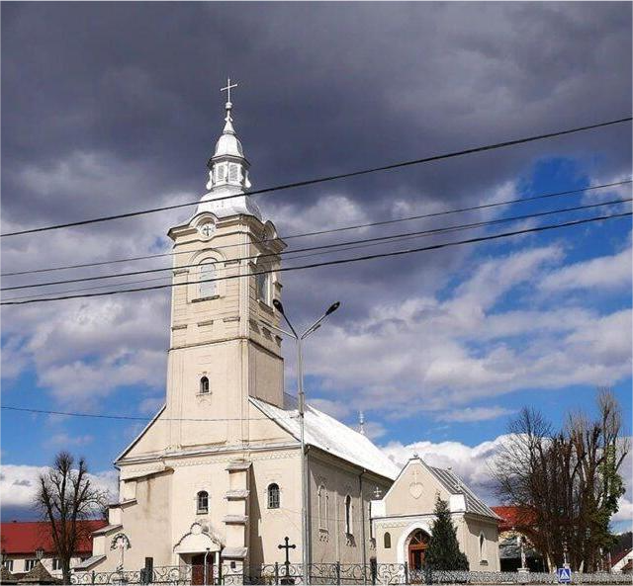
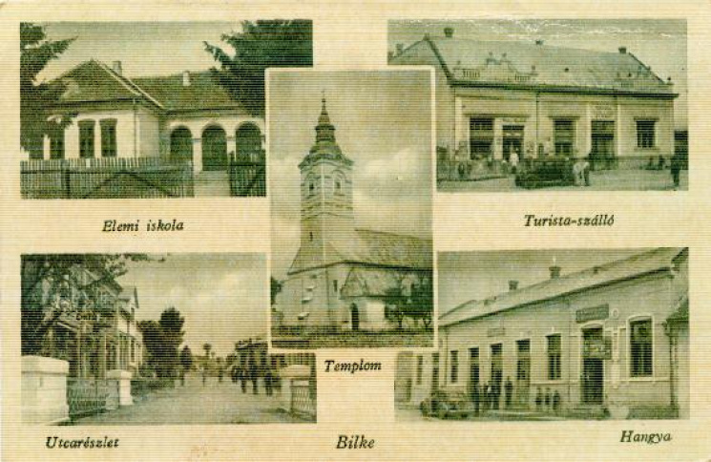
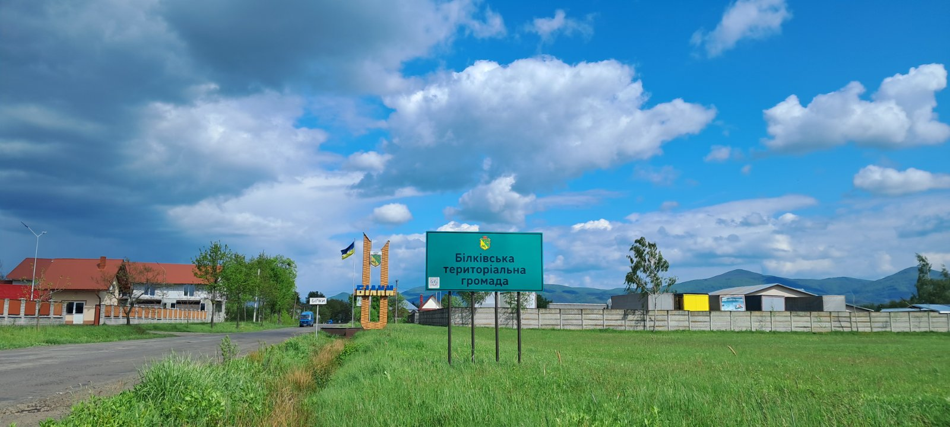
BILKIVSKA RURAL TERRITORIAL
COMMUNITY

Slide 2
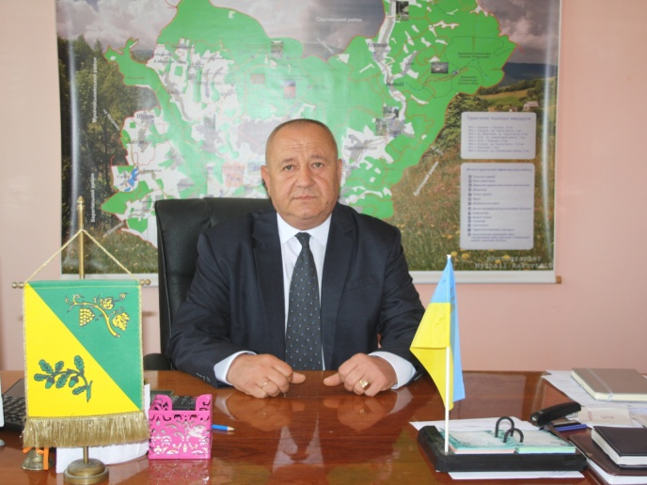
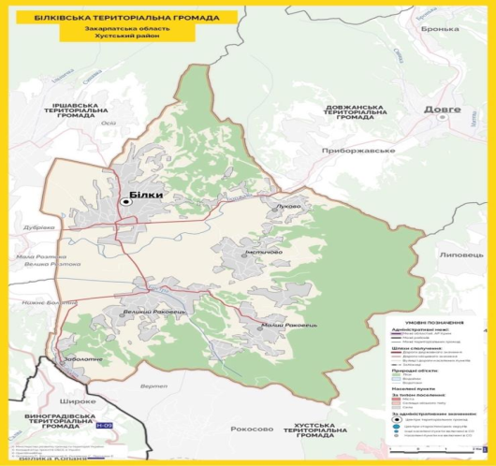

INVITES TO COOPERATION!
WELCOME TO THE BILKIVSKA TERRITORIAL COMMUNITY OF KHUST DISTRICT ZAKARPATTIA REGION!
OUR COMMUNITY IS A RURAL COMMUNITY WITH A RICH CULTURAL AND HISTORICAL HERITAGE, WHERE HAPPY AND HEALTHY PEOPLE LIFE SAFELY
OUR OPPORTUNITIES :
- DEVELOPMENT OF HORTICULTURE, VILTICULTURE , CROP PRODUCTION , ORGANIZATION OF PROCESSING THESE PRODUCTS ;
- STEADY GROWTH IN DEMAND FOR AGRICULTURAL PRODUCTS;
- LAUNCHING NEW INDUSTRIAL PRODUCTS ;
- ATTRACTION OF INVESTMENS AND IMPROVE OF INVESTMENT ATTRACTIVENESS;
- NEW SPORTS, RECREATIONAL AND TOURIST FASILITIES ;
- DEVELOPMENT OF CROSS- BORDENER COOPERATION PROGRAM ;
- FOCUSING ON IMPROVING SOCIAL STANDARDS OF LIVING ;
- ESTABLISHING COOPERATION WITH OTHER TERRITORIAL COMMUNITIES TO IMPLEMENT SOCIAL, INFRASTRUCTURE AND CULTURAL PROJECTS .
BILKIVSKA VILLAGE HEAD
VASYL ZEYKAN

Slide 3
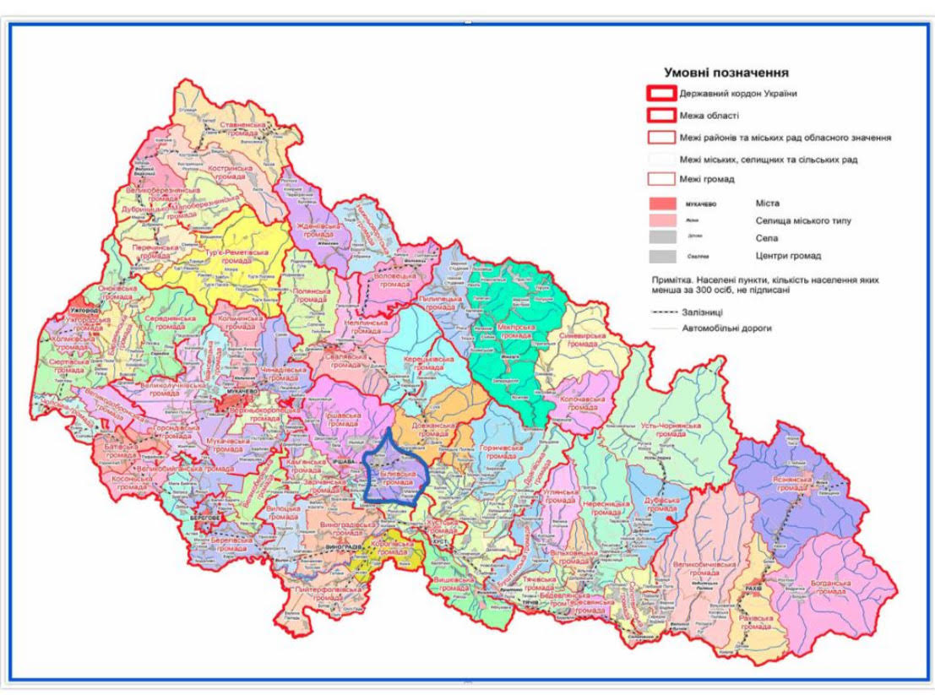
BILKIVSKA COMMUNITY WAS ESTABLISHED 2020. It consist of six settlements : Bilky , Velikiy Racovets , Maliy Racovets , Nyzhnie Bolotne , Imstichovo , Lukovo. The administrative centre of community is the village of Bilky.
Area - 149,6 км2; population - 20 700 people.; population density - 138 people per 1 км2.
Our community borders the following communities : Dovzanska , Vynogradivska , Irshavska , Khustska .
Website : https://bilkigr.gov.ua/
DISTANCES: Vinogradiv - 36 км
Khust - 42 км
Beregovo - 47 км
Mukachevo - 51 км
Uzhorod- 92 км
Rakhiv - 148 км
Lviv - 270 км
Kyiv - 812 км
To the Hungarian border- 44 км
To the Romanian border - 58 км
To the Slovak border - 92 км
To the Polish border - 246 км

Slide 4
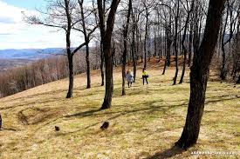
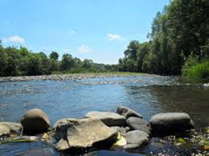
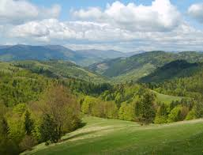
NATURAL RESOURSES
Structures of land and natural recourses :
Forests and shrubs – 54 % of territory ;
Climate– moderately continental ;
Agricultural land – 24 % of territory ;
Water resources – Borzhava River -13 км long
Minerals – brown coal , andisite – dacities , natural mineral paints ( pigments ) , ceramic clay , mineral water
Soils - suitable for growing fruits and agricultural crops

Slide 5
MAIN DEVELOPMENT GOALS OF THE BILKILSKA TERRITORIAL COMMUNITY
STRATEGIC GOAL 1 ECONOMICAL VIABLE COMMUNITY | STRATEGIC GOAL 2 COMMUNITY OPEN TO PEOPLE | STRATEGIC GOAL 3 COMMUNITY WITH ENERGY- EFFICIENT INFRACTRUCTURE FOR COMFORTABLE AND SAFE LIVING , FRIENDLY TO THE ENVIRONMENT
Development of the agricultural sector and attraction of investments | Development of human potential | Construction and renewal of networks and infrastructure facilities in the company
Promoting entrepreneurship development | Formation of an active life position among community residents | Safe , energy – efficient and comfortable living
Development of turism |  | Community planning
 |  | Environmentally friendly community

Slide 6
POPULATION OF THE COMMUNITY
As of January,1, 2024 the community has a population of 20700 people

Slide 7
COMMUNITY BUDGET

Slide 8
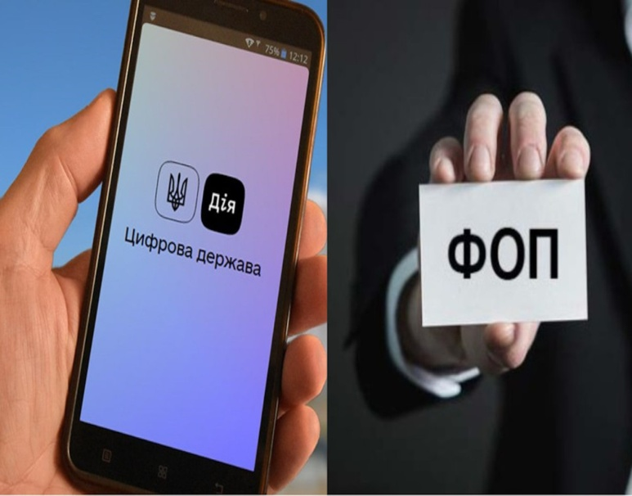
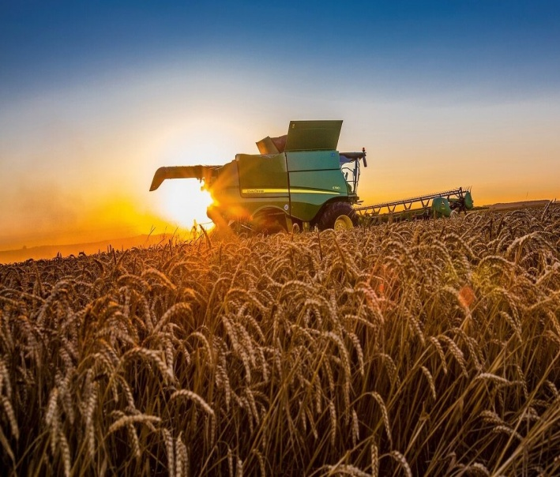
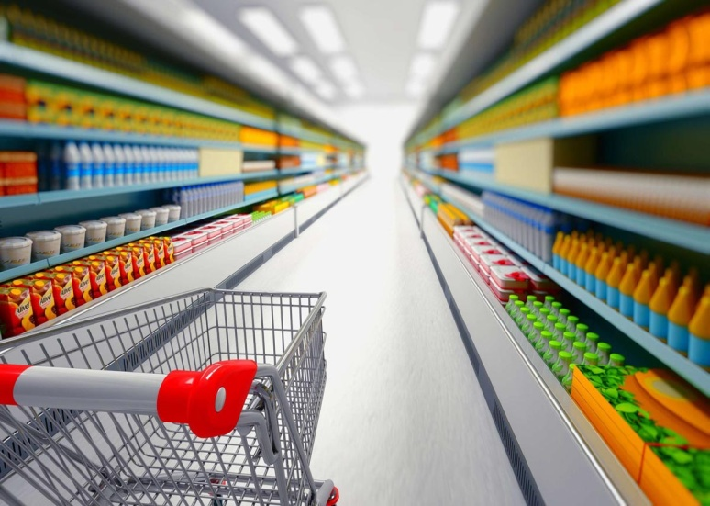
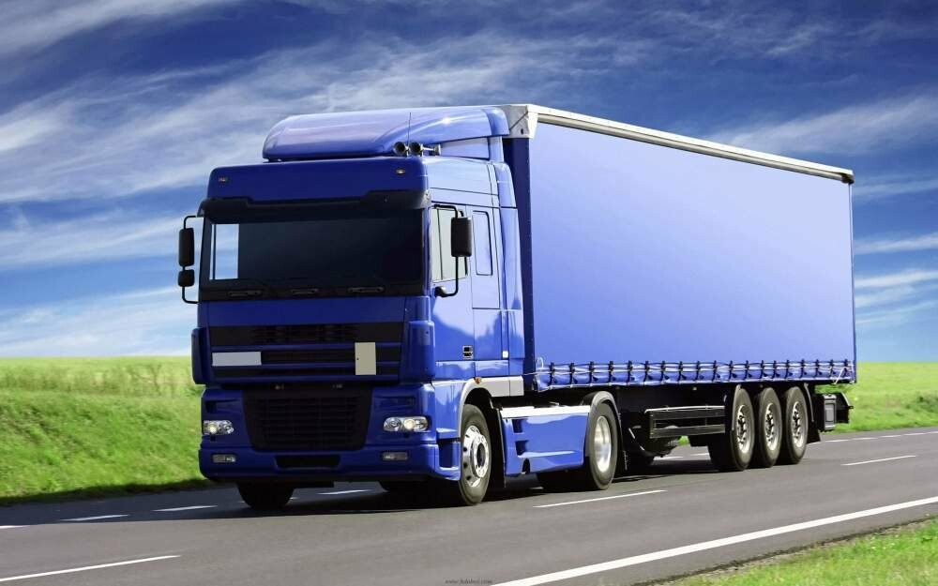
ECONOMIC ENVIRONMENT
AGRICULTURE
TRANSPORT
SERVICE SECTOR
FOREST MANAGEMENT
WHOLESALE AND RETAIL TRADE

Slide 9
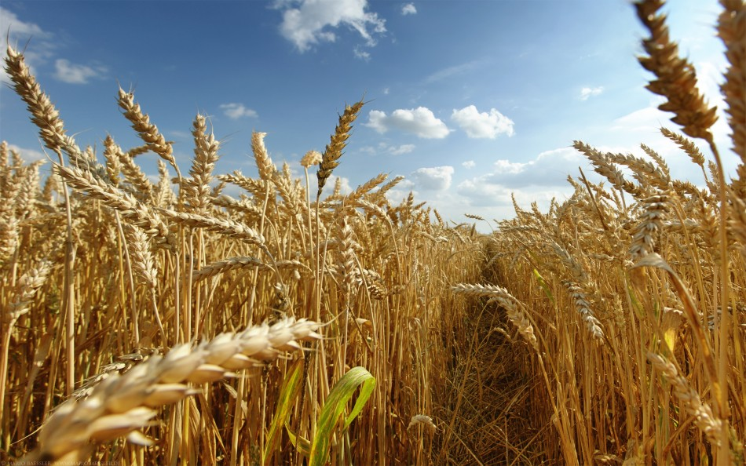

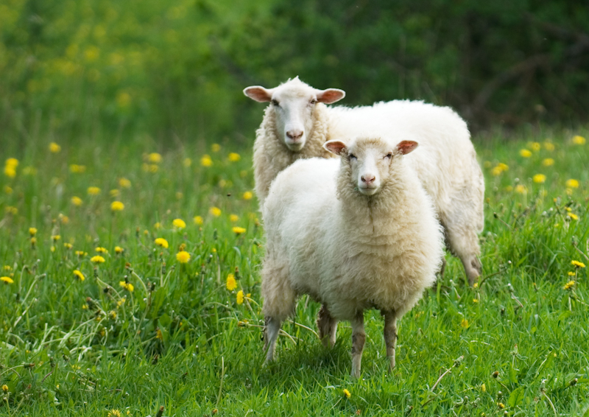
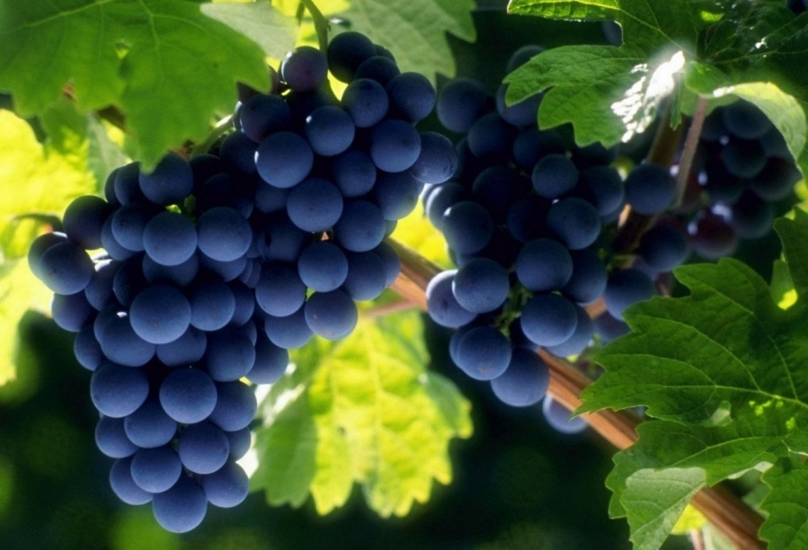
AGRICULTURE
CROP PRODUCTION : GROWING CELEALS AND VEGETABLES;
HORTICULTURE : GROWING FRUIT, BERRY , NUT CROPS;
VILTYCULTURE AND WINEMAKING;
ANIMAL HUSBANDRY : BREEDING CATTLE, GOATS, HORSES;
SHEEP FARMING ;
BEEKEEPING .

Slide 10
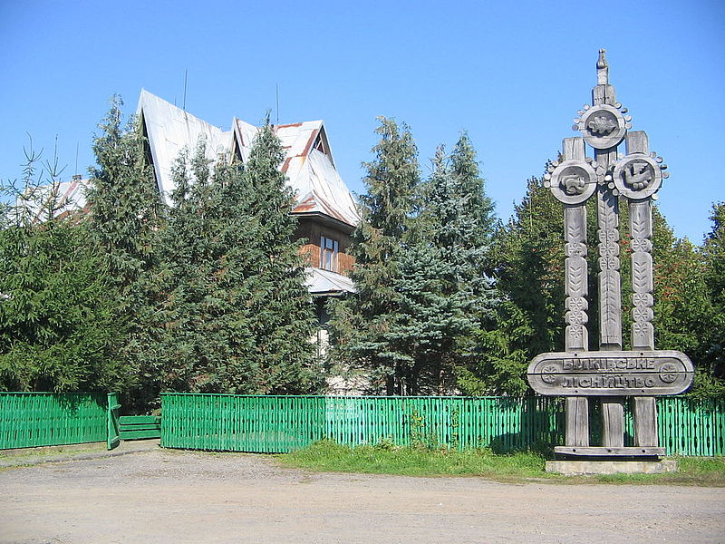
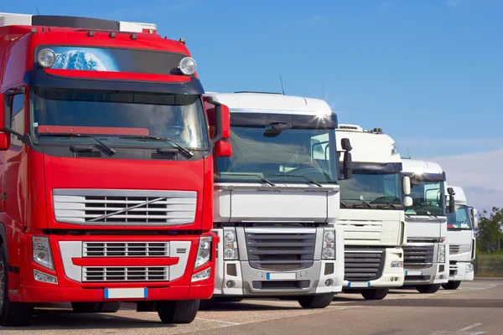
FOREST AND TRANSPORT
THE FOREST AREA IS ABOUT 70 KM²
SOLE PROPRIETORSHIP – 57

Slide 11
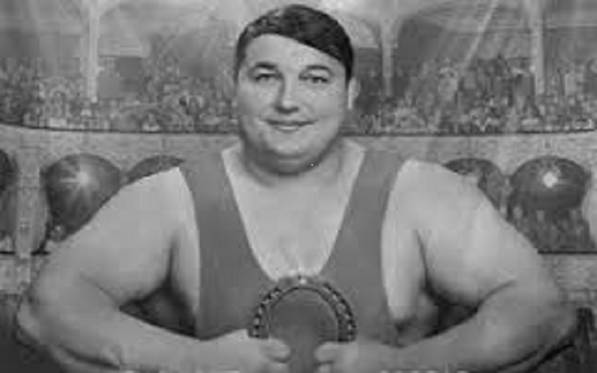
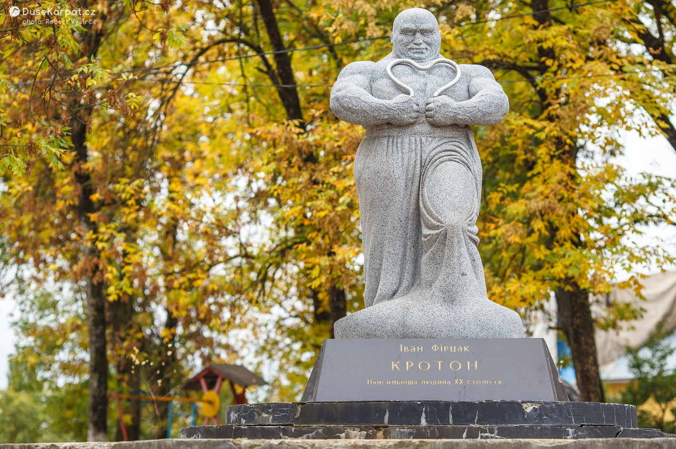
HISTORICAL AND CULTURAL HERITAGE
IVAN FIRTSAK was born on July 28, 1899 in the village of Bilki , a Ukrainian wrestler, boxer, freestyle fighter , strongman and circus artist . In 1928 , he was recognized as the strongest man on the planet . Some of his strength feats have not been replicated .

Slide 12
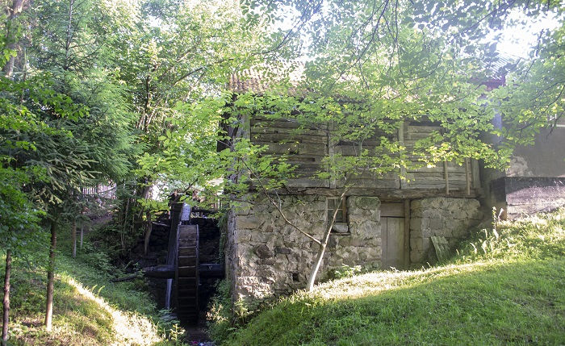
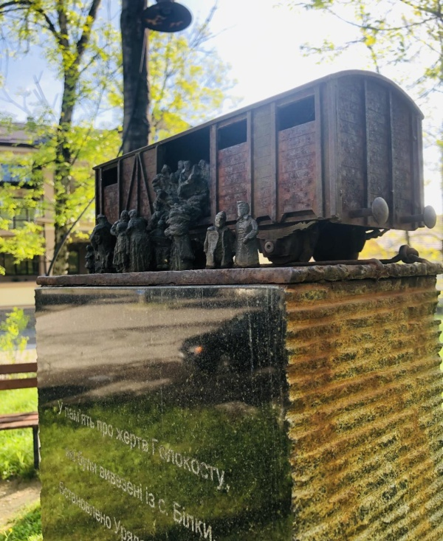
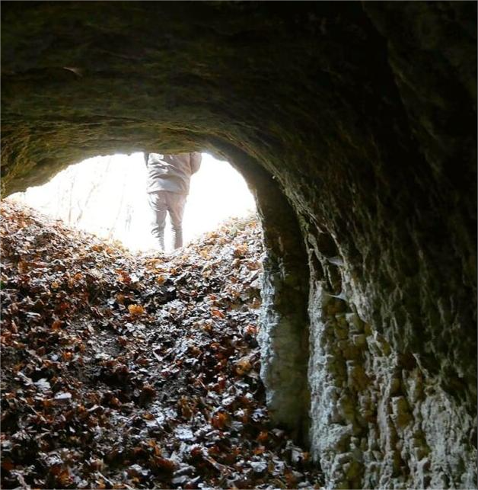
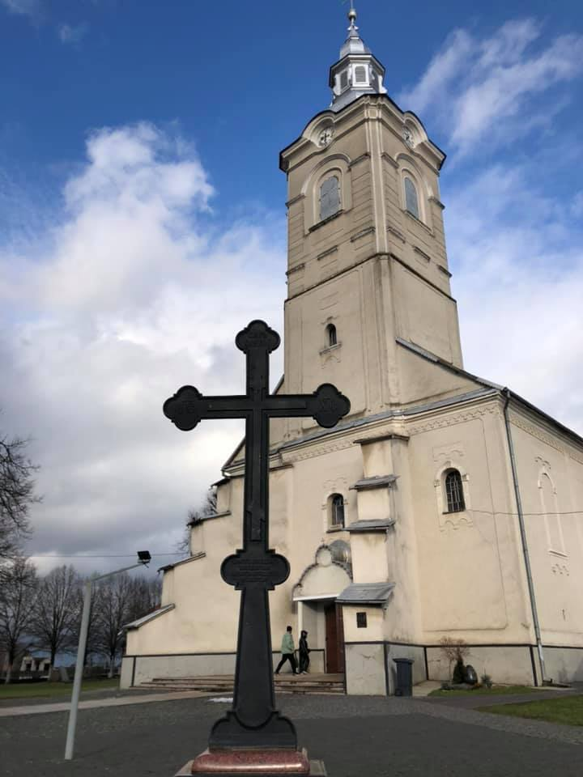
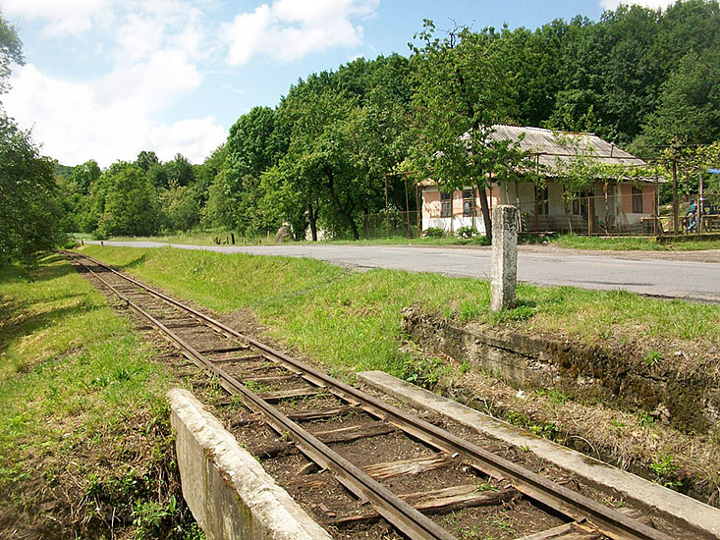
INTERESTING LOCATION WORTH VISITING
WATER MILLS
SOBRIETY CROSS
REMAINS OF A UNIGUE NARROW- GAUGE RAILWAY
MINI-SCULPTURE IN MEMORY OF HOLOCAUST VICTIMS
CAVE ( FORMER IRON ORE MINE )

Slide 13

COMMUNITY CHALLENGES
Lack of processing and marketing facilities for agricultural , horticultural , livestock and viticulture products ;
Limited budget recourses , low level of financial capacity ;
Lack of tourist infrastructure facilities and recreational cities;
Unsatisfactory condition of a significant part of public and local roads
Need of construction of communal networks , including treatment facilities ;
Environment problems : lack of official landfill and waste management system.

Slide 14
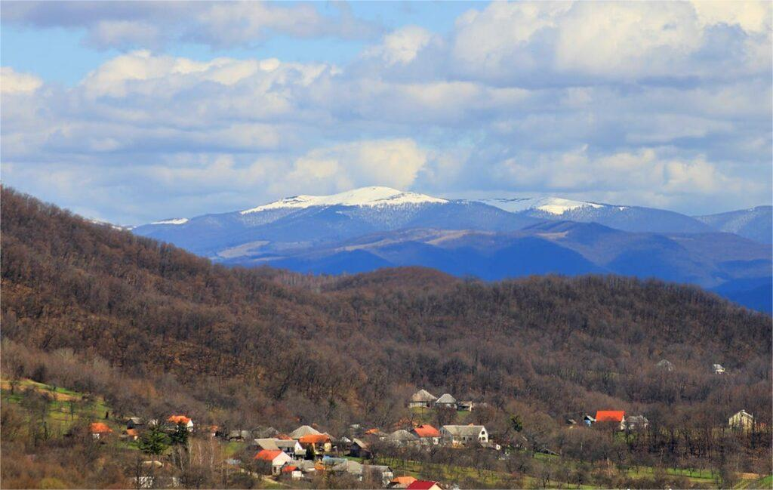
THANK YOU FOR YOUR ATTENTION!

